Slide 1
Bind the bot to a Facebook Page and test it
Notes:
[Mandatory Slide] This would be the introduction slide of the topic that you are covering in this subsection.
When this slide plays, you could talk about the main aim that we’d be covering in this video.

Slide 2
In this Video, we are going to take a look at…
Create a Facebook Page
Configure communication with the bot
Test the bot
Notes:
[Mandatory Slide]
Before the start of the video, we’d like to highlight what are important topics or pointers that we’d be covering in this video. This slide would immediately follow the intro/name slide. This would just be say 2-3 points for the viewers to know what they are getting into.

Slide 3
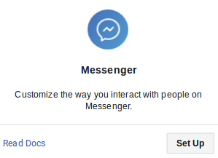
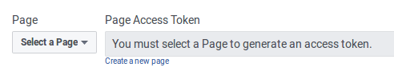
Create a Facebook Page
Signup on Facebook
Create a new Facebook Page
Top-right menu → Create a Page → assign a name (any classification is OK)
Create a Facebook App
Signup on https://developers.facebook.com/quickstarts/?platform=web for a Facebook for Devs account
Create a new App
Click on the “Messenger” card on the App’s dashboard to setup the integration with Messenger service
Under “Token generation” select the page we created before, then take note of the generated value: this is the PAGE_ACCESS_TOKEN value
Notes:
[Mandatory Slide]
Before the start of the video, we’d like to highlight what are important topics or pointers that we’d be covering in this video. This slide would immediately follow the intro/name slide. This would just be say 2-3 points for the viewers to know what they are getting into.

Slide 4
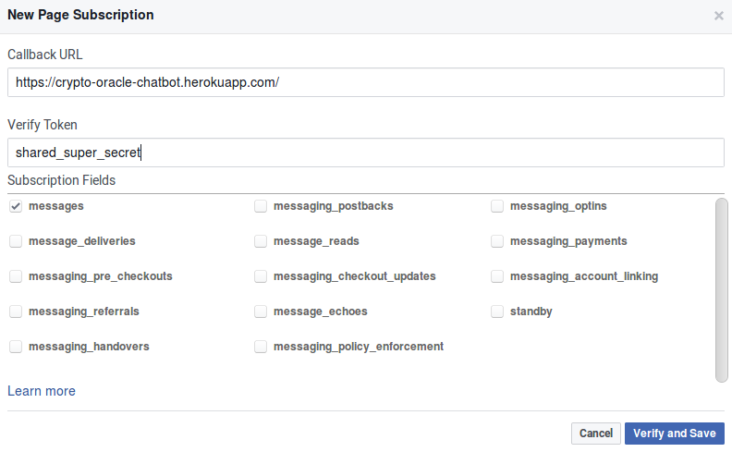
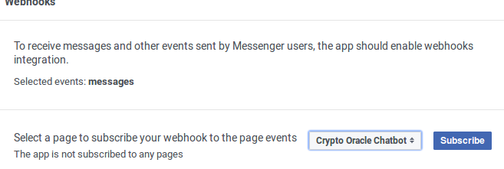
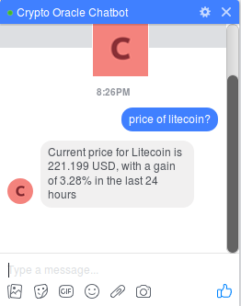
Configure communication with the bot
Click on “Setup Webhooks” and then write/select:
Callback URL: https://cryptospokesman.herokuapp.com/
Verify Token: anything you like, better if randomically generated (this is the VERIFY_TOKEN value)
Subscription Fields: tick only “messages”
Setup the PAGE_ACCESS_TOKEN and VERIFY_TOKEN values as env variables for the Heroku app and redeploy it
Get back on Facebook and hit “Verify and Save”. Then select our Facebook page as the event source we want the bot to subscribe to
… now open a chat with our Page and start chatting with the bot!
Also don’t forget that now only you can message with the bot
You need to submit the App to Facebook for review in order to allow the bot to be publicly accessible (eg. by your friends)
Notes:
[Mandatory Slide]
Before the start of the video, we’d like to highlight what are important topics or pointers that we’d be covering in this video. This slide would immediately follow the intro/name slide. This would just be say 2-3 points for the viewers to know what they are getting into.

Slide 5
Code Sample
Notes:
Something that needs to grab the viewers attention!!

Slide 6
Summary
Create a Facebook Page
Configure communication with the bot
Code sample
Notes:
[Mandatory Slide]
Before the start of the video, we’d like to highlight what are important topics or pointers that we’d be covering in this video. This slide would immediately follow the intro/name slide. This would just be say 2-3 points for the viewers to know what they are getting into.

Slide 7
Datasets manipulation and visualization with Jupyter and Pandas
Next Section
Notes:
[Mandatory Slide]
Here the name of the next section needs to be mentioned. The narration as you guessed it would be just letting the viewer know what we’d be taking over next! ☺

